Slide 1
Planning & Development
Hazardous Areas Development Permit Area
Open House
December 2021

Slide 2
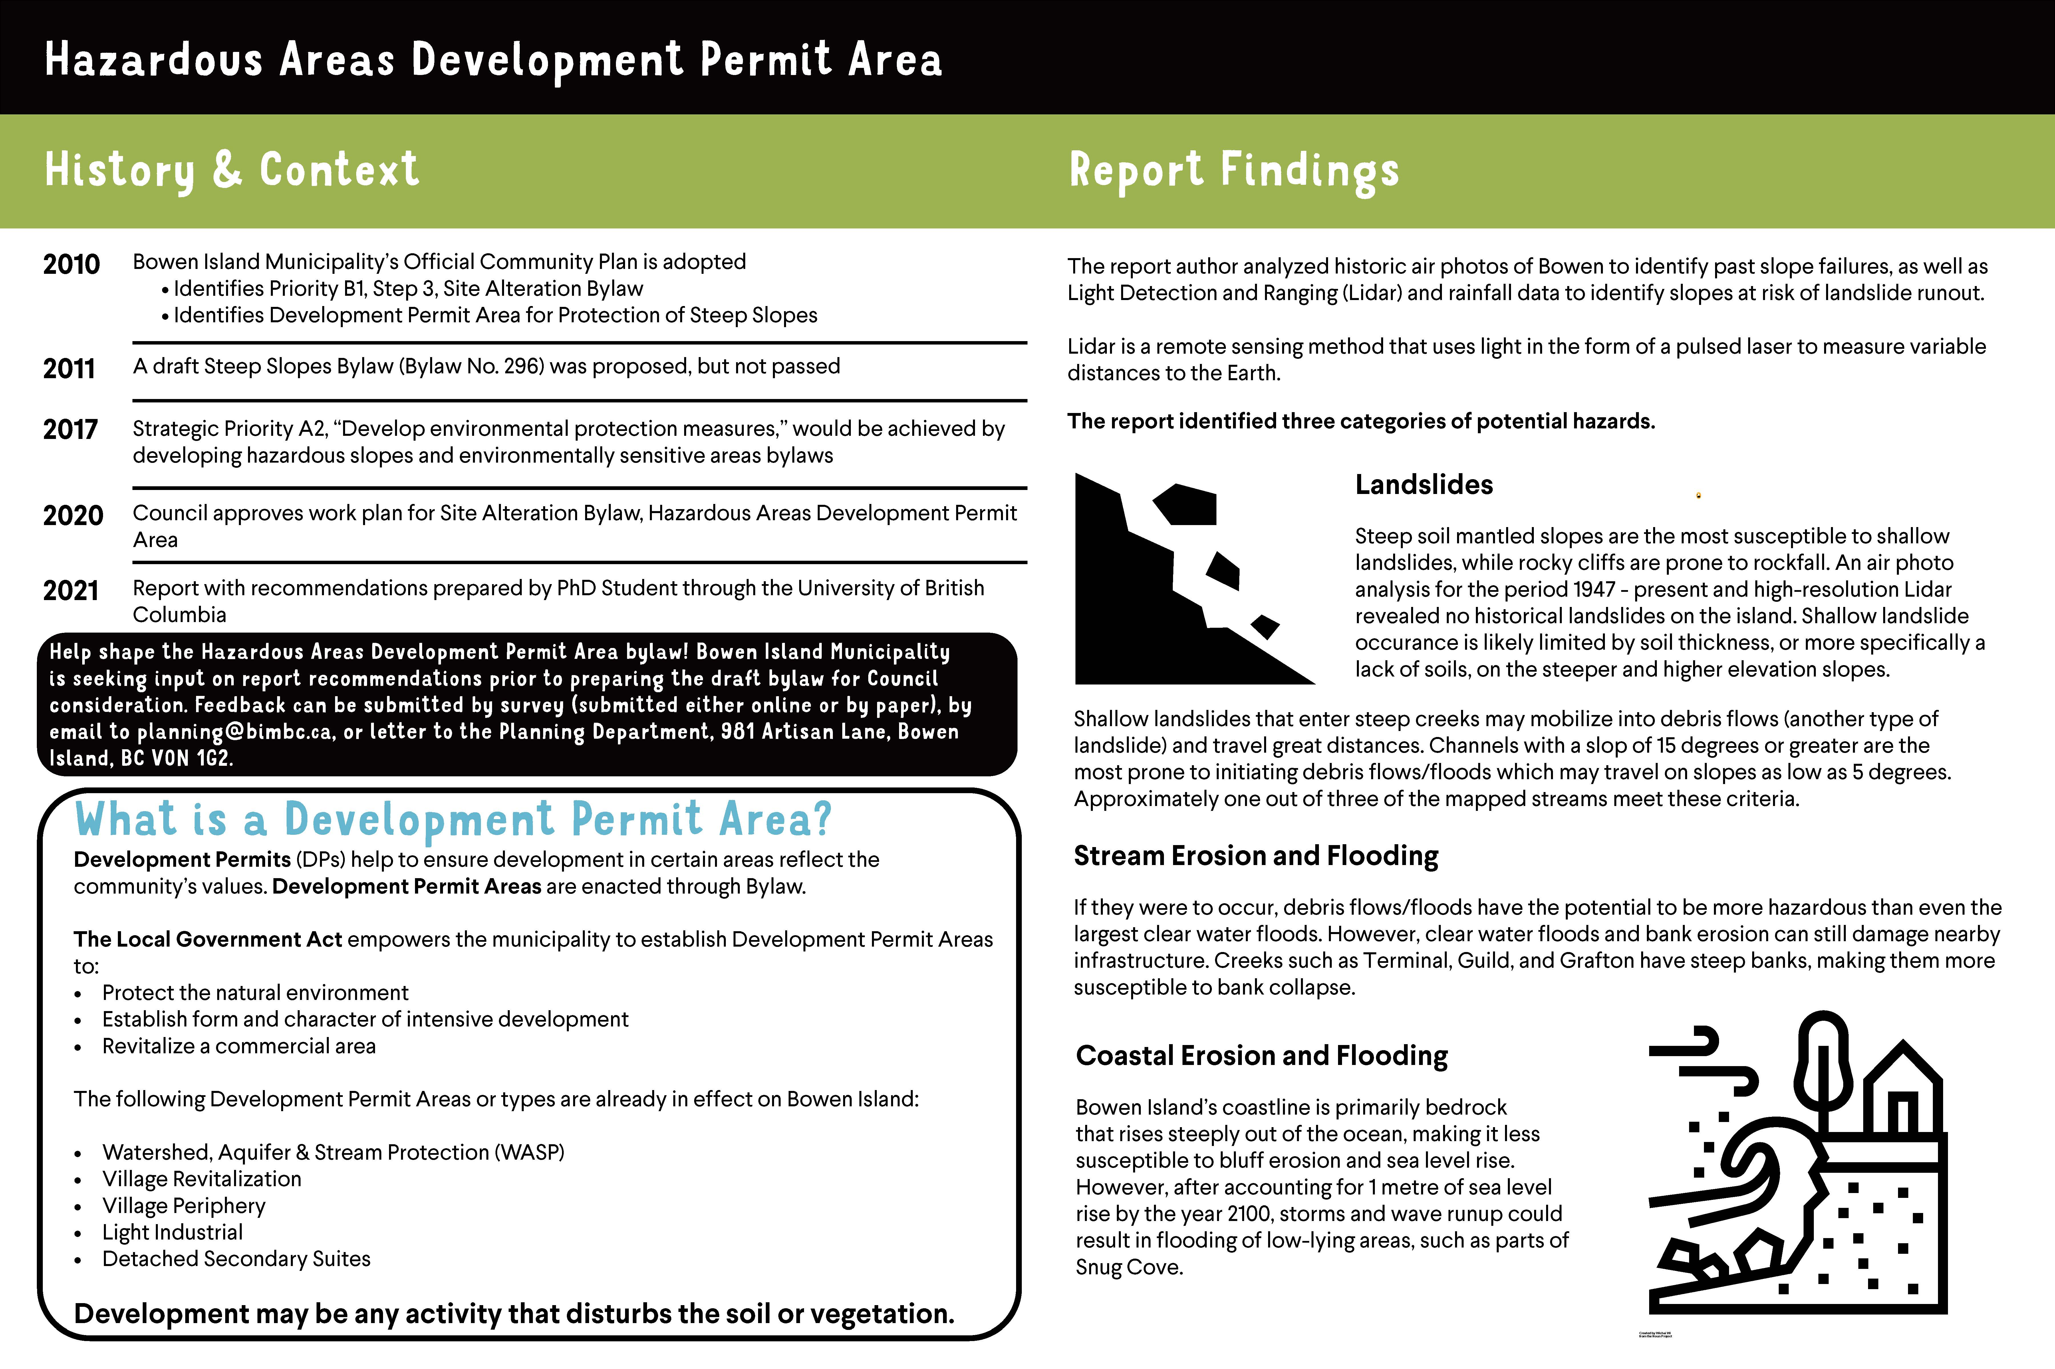
History & Context

Slide 3
Potential Hazards

Slide 4
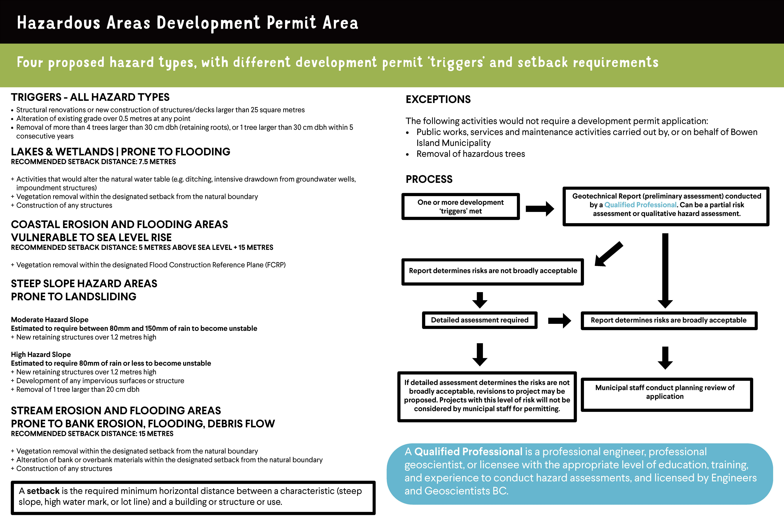
Proposed Development Permit “Triggers”

Slide 5
Proposed Process

Slide 7
Ways to Have Your Say
Online Survey available on this proposal at:
https://bowenisland.citizenlab.co/en/projects/hazardous-areas
Or provide comment and this open house, or by email to me at dmartin@bimbc.ca
Staff to collect all feedback and present to Council in the New Year
Following Council direction, staff to draft bylaws and conduct further engagement on the content of the bylaws
www.bowenislandmunicipality.ca/hazardous-areas-development-permit-area

